Slide 1
Chapter 12 :: Web Application : Vacation Tracking System Group 2
Jake Adkins George Jackson
Nick Bester

Slide 2
The Problem
Develop and deploy a flexible vacation time management application for managers and employees alike to use to manage their vacation time.
Keep in mind…
It is unlikely that this proposed system is the first that this organization has ever created. I.E. Design must be considered in the context of existing or new systems
Platform
Focus:
Web application development
Logical analysis of requirements
Web Application Development Process
Notes:
Platform: Web is best because it will exist as an extension to the organization’s existing intranet, thus providing a convenient and natural entry point for its users.

Slide 3

Vision Document
A vacation Tracking System (VTS) will provide individual employees with the capability to manage their own vacation time, sick leave, and personal time off, without having to be an expert in company policy or the local facility’s leave policies.
$⇒$ Motivation
Stream line functions of HR
Minimize noncore related activities of management
Empower employees
Notes:
These objectives will only be met if the system is easy to use, intuitive, and intelligent; therefore, the overriding goal becomes… (Next slide) – Remember Downie Jr. ;)
Don’t read just explain

Slide 4

“The system must be easy to use.”
Notes:
-This isn’t measurable, and it’s so subjective how can it be a goal?
-It tells us how to make decisions.
-Something complex (high risk) to implement makes system easier to use, it can now be justified -This is something you can use in your project

Slide 5
System Function Statement
Main Requirement: Improve internal business process of managing vacation requests – in that before each request required a manager and HR clerk’s consent
With the system, it will require at most one approval by immediate manager if that.
Notes:
Describe old way vs new way

Slide 6
System Function Statement
Implements a flexible rules-based system for validating and verifying leave time requests
Enables manager approval (optional)
Provides access to requests for the previous calendar year, and allows requests to be made up to a year and a half in the future
Uses e-mail notification to request manager approval and notify employees of request status changes
Uses existing hardware and middleware
Is implemented as an extension to the existing intranet portal system, and uses the portal’s single-sign-on mechanisms for all authentication
Keeps activity logs for all transactions
Enables the HR and system administration personnel to override all actions restricted by rules, with logging of those overrides
Allows managers to directly award personal leave time (with system-set limits)
Provides a Web service interface for other internal systems to query any given employee’s vacation request summary
Interfaces with the HR department legacy systems to retrieve required employee information and changes
Notes:
Middle top and bot right

Slide 7
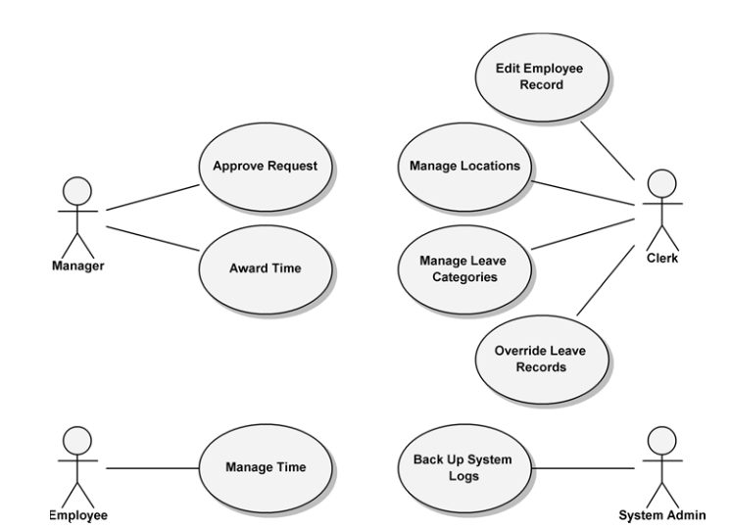
Top-Level Use Case
Notes:
Use case names and web page names – unique to web dev

Slide 8
Top-Level Use Case
Manage Time: Describes how employees request and view vacation time requests.
Approve Request: Describes how a manager responds to a subordinate’s request for vacation time.
Award Time: Describes how a manager can award a subordinate extra leave time (comp time).
Edit Employee Record: Describes how an HR clerk edits an employee’s information in the system. This includes setting all the leave time allowances and the maximum time that can be awarded by the manager.
Manage Locations: Describes how an HR clerk manages location records and their rules.
Manage Leave Categories: Describes how an HR clerk manages leave categories and their rules.
Override Leave Records: Describes how an HR clerk may override any rejection of leave time requests made by the rules in the system.
Back Up System Logs: Describes how the system administrator backs up the system’s logs.
Notes:
Come back and ask questions.. Pretty straight forward

Slide 9
Elaboration
It is important to have most important and architecturally significant use cases described and discussed before development.
All details need not be complete but architecturally significant ones should be addressed
In an ideal world, the analysis should be independent from implementation
Especially true for web development
Notes:
-Diagram relations :: Deployment and use case (if you are building use case for web, deployment for web)
-Building web based was an integral design decision made early on
-(last bullet) Windows calendar included in c#, not IE

Slide 10
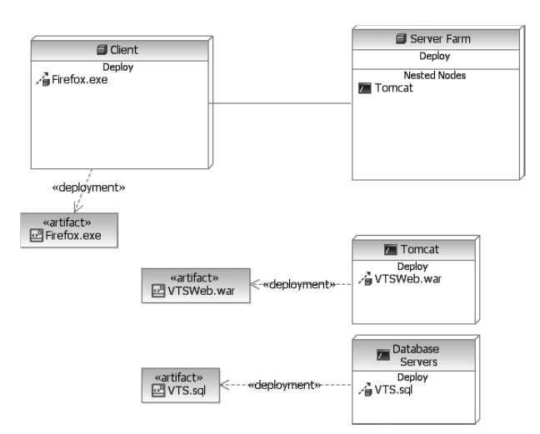
Deployment View
Cloudscape
Notes:
Two main nodes: Server and client
Tomcat and Cloudscape treated as nested nodes of the server (Tomcat == JSP)
Client has a communication link to server

Slide 11
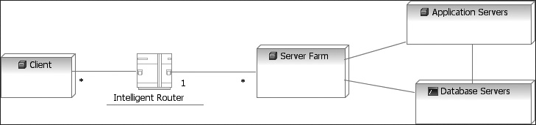
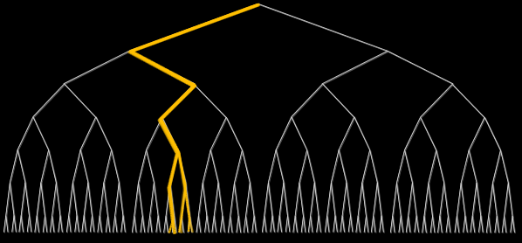
A Deployment Diagram for a Web Application Server Farm with Parallel and Redundant Processing Nodes
Notes:
In larger systems the deployment would become more complex with, for example, network topologies. To start, we scale these application by adding additional processing nodes, to avoid the complex details initially. Also something you can use

Slide 12
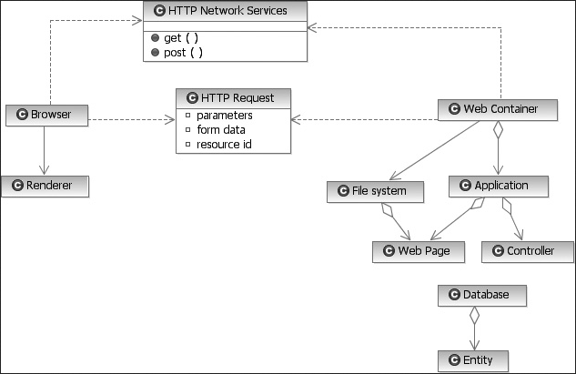
High-Level Logic View (Class Diagram with Relations)
Notes:
-Shows client and server working together
-Should look familiar – CCN
-Motivation: Security, Web container invokes what is needed and client never has direct access to the system

Slide 13
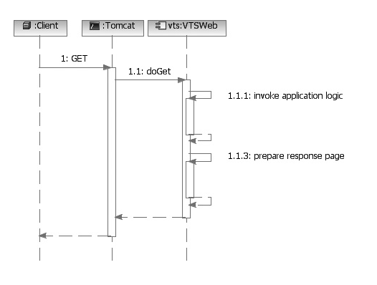
Sequence Diagram of an HTTP GET Request
The client and server are never connected longer than it takes to process the GET or POST request
Server uses the request to determine which resource to use and triggers the “business logic”.
Application prepares a response page
Application stops

Slide 14
Client State Management
Every request and response between the client and server is completed with a new and unique connection
A single use case scenario involves navigating through a number of different web pages
Solutions
HTTP State Management Mechanism (Cookie): ID used as key to map on the server where all info for each client is stored.
URL redirections: Appending information to the end of the URL [Requires all web pages to be dynamic and can only enter through the beginning of the use case]
Without exploiting features of HTTP or implementing certain architectures, a server would experience extreme difficulty in handling its clients.
Notes:
-(Bullet 2): If there were no state management mechanisms, you would have to continually supply all previous info entered for each new web page.
-(Last bullet): Also worth mentioning that connection can drop between pages in a use case so never do an important action between pages

Slide 15
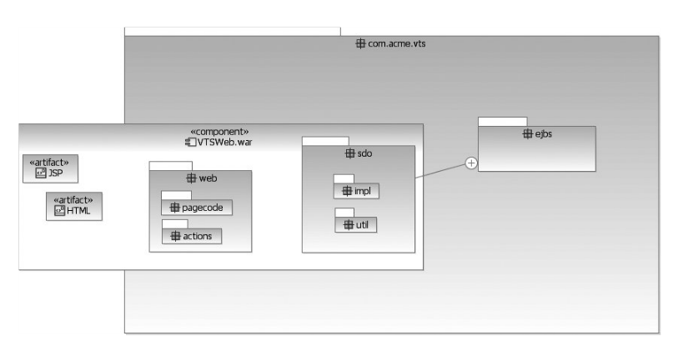
Implementation/Use Cases
Some resources result in business logic processing, while others simply display static data.
By assembling an entire collection of web pages, all specialized to display and accept specific information that is part of the application, an entire business process can be implemented.
The Deployment View would describe in more detail the deployment of the components in the tiers, and the Logical View would describe in more detail the nature and responsibility of the components
Notes:
Class Category Diagram:
VTSWeb contains JSP and HTML, as well as java classes, and sdo packages (Used in business logic.) com.acme.vts is shown as the name space.

